Slide 1
Airbnb Booking Success

Slide 2
Goals
For this project, the aim is to :-
Propose some key metrics that the team at Airbnb can use to track the success of Guest Host matching process.
Analyze the dataset based on the obtained metrics to understand areas/segments for improvement while suggesting some business initiatives to increase the number of bookings in Rio de Janeiro.

Slide 3
Key Metric I
Success rate of enquires - (No. of enquires that led to booking) / (Total no. of enquires) If this metric improves over time that means more no. of enquires are resulting in booking thereby improving guest-host matching process. we can compare this metric month-wise, e.g. By how much percent success rate has increased/decreased this month compared to previous month. select round(avg(case when ts_booking_at is not null then 1 else 0 end) * 100, 2) from contacts;
overall success rate - 41.55

Slide 4
Key Metric II
Average host acceptance rate - Average of (No. of enquires that the host accepts) / (Total no. of enquires) for all the hosts. If this improves over time, that means on an average hosts are accepting more no. of enquires leading to more bookings thereby contributing to guest host matching process. with cte as (select id_host_anon, avg(case when ts_accepted_at_first is not null then 1 else 0 end) * 100 as acceptance_rate from contacts group by 1) select round(avg(acceptance_rate), 2) from cte;
Result - 53.15%

Slide 5
KEY METRIC III
Post acceptance drop-off rate - (No of accepted enquires that did not led to booking) / (Total no of accepted enquires) If this decreases over time, that means more no of accepted enquires are resulting in booking thereby improving guest-host matching process. This metric can be used to study the efficiency of accepted enquires for booking select round(avg(case when ts_booking_at is null then 1 else 0 end) * 100, 2) from contacts where ts_accepted_at_first is not null;
Result - 29.41

Slide 6
KEY Metric IV
Average no. of new guests on Airbnb each month If this metric improves over time, that means more no. of new guests enquiring about listings each month, i.e. more no of enquires which indirectly leads to more booking thereby contributing to guest-host matching process WITH cte as (select to_char(ts_interaction_first, 'YYYY-MM') as month, count(distinct id_guest_anon) as no_of_new_guests from contacts where guest_user_stage_first = 'new' group by 1) select round(avg(no_of_new_guests)) from cte;
Result - This means that on an average about 2274 new guests enquire about the listings in Rio de janeiro each month

Slide 7
Insight I
Observation –
Now from the given statistics,
About 46% of the enquires for booking is through contact_me option
Out of which only ~42% of them are accepted by the host and rest of them are rejected
Now out of those ~42%, only ~17% result in booking, and ~83% are dropped of by the guests.
To improve the guest-host matching process, 1. Hosts need to accept more no of enquires (increasing host acceptance rate) 2. Guests also need to book more after being approved by the host (decreasing the drop-off rate) Suggestions –
we can setup a reward system to motivate guests and host to promote bookings such that every time a host accepts an enquiry for booking he/she gets a reward point similarly every time a guest books a listing, they get a reward point. Reward points can later be converted into cashback that benefit guests or trending time period for listings that benefit hosts.

Slide 8
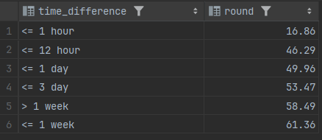
Correlation I
Q. What effect does delay in acceptance have on drop-off rate.
Ans. As you can see that, when the host accepts the enquiry for booking within 1 hour, least no. of guests drops off from booking after being accepted but this drop-off percentage increases gradually when the host takes longer period of time to accept.

Slide 9
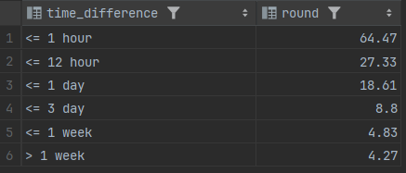
Correlation II
Q. What effect does delay in reply have on success rate of booking?
Ans. As you can see that,
About 64% of enquires result in successful booking when the host replies within 1 hour of the enquiry,
and this rate of successful booking drops drastically when host takes longer period of time to reply.

Slide 10
Correlation Analysis Result
Observation -
From the previous two correlation analysis, it clear that the host must quickly reply and accept the enquiry to increase the booking success and reduce drop-off rates. Suggestions -
Now to motivate hosts to reply and accept quickly, we should implement a strategy for hosts based on their responsiveness such that if a host responds late to an enquiry it can reduce its visibility on the platform (or its listings visibility) but if the host replies promptly it can increase its visibility (which indirectly promotes business).

Slide 11
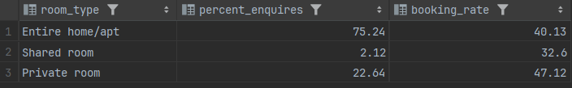
Insight II
Observation –
From the statistics above,
About 75% of the enquires are for entire home/apt making it the most popular choice, but in terms of booking it lags behind private room for which rate of successful booking is the highest.
2. Shared rooms struggle in terms of popularity and bookings with only 32% of successful booking rate out of 2% enquires.
Suggestions –
Now we should focus more on
1. Improving the popularity of shared rooms, this can be done by highlighting (or increasing the visibility) shared rooms by setting it as the default choice for room_type 2. And for the most popular option, its booking rate i.e. we can offer discounts on highly priced listings to enable guests to book more.

